Slide 1
Data Normalization
Functional Dependencies

Slide 2
Well-Structured Relations
A relation that contains minimal data redundancy and allows users to insert, delete, and update rows without causing data inconsistencies
Goal is to avoid anomalies
Insertion Anomaly – adding new rows forces user to create duplicate data
Deletion Anomaly – deleting rows may cause a loss of data that would be needed for other future rows
Modification Anomaly – changing data in a row forces changes to other rows because of duplication
General rule of thumb: a table should not pertain to more than one entity type

Slide 3
Data Normalization
Primarily a tool to validate and improve a logical design so that it satisfies certain constraints that avoid unnecessary duplication of data
The process of decomposing relations with anomalies to produce smaller, well-structured relations

Slide 4
Example – Figure 5.2b
Question – Is this a relation?
Answer – Yes: unique rows and no multivalued attributes
Question – What’s the primary key?
Answer – Composite: Emp_ID, Course_Title

Slide 5
Anomalies in this Table
Insertion – can’t enter a new employee without having the employee take a class
Deletion – if we remove employee 140, we lose information about the existence of a Tax Acc class
Modification – giving a salary increase to employee 100 forces us to update multiple records
Why do these anomalies exist?
Because we’ve combined two themes (entity types) into one relation. This results in duplication, and an unnecessary dependency between the entities

Slide 6
Normalization Types
We discuss four normal forms: first, second, third, and Boyce-Codd normal forms
1NF, 2NF, 3NF, and BCNF
Normalization is a process that “improves” a database design by generating relations that are of higher normal forms.
The objective of normalization:
“to create relations where every dependency is on the key, the whole key, and nothing but the key”.

Slide 7
Normalization
There is a sequence to normal forms:
1NF is considered the weakest,
2NF is stronger than 1NF,
3NF is stronger than 2NF, and
BCNF is considered the strongest
Also,
any relation that is in BCNF, is in 3NF;
any relation in 3NF is in 2NF; and
any relation in 2NF is in 1NF.

Slide 8
Normalization
1NF
a relation in BCNF, is also in 3NF
a relation in 3NF is also in 2NF
a relation in 2NF is also in 1NF
2NF
3NF
BCNF

Slide 9
Normalization
We consider a relation in BCNF to be fully normalized.
The benefit of higher normal forms is that update semantics for the affected data are simplified.
This means that applications required to maintain the database are simpler.
A design that has a lower normal form than another design has more redundancy. Uncontrolled redundancy can lead to data integrity problems.
First we introduce the concept of functional dependency

Slide 10
Functional Dependencies and Keys
Functional Dependency: The value of one attribute (the determinant) determines the value of another attribute
Candidate Key:
A unique identifier. One of the candidate keys will become the primary key
E.g. perhaps there is both credit card number and SS# in a table…in this case both are candidate keys
Each non-key field is functionally dependent on every candidate key

Slide 11
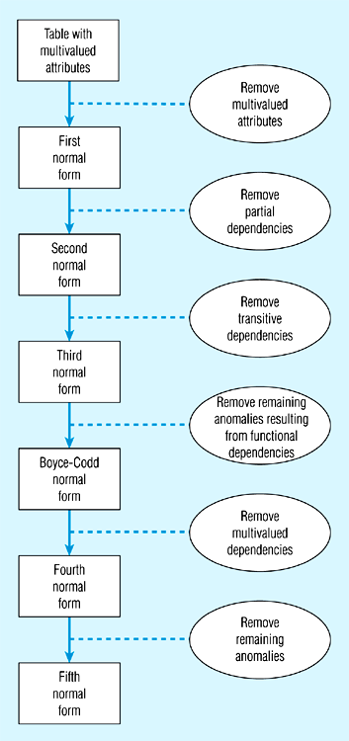
5.22 -Steps in normalization

Slide 12
Functional Dependencies
Functional Dependencies
We say an attribute, B, has a functional dependency on another attribute, A, if for any two records, which have
the same value for A, then the values for B in these two records must be the same. We illustrate this as:
A → B
Example: Suppose we keep track of employee email addresses, and we only track one email address for each employee. Suppose each employee is identified by their unique employee number. We say there is a functional dependency of email address on employee number:
employee number → email address

Slide 13
Functional Dependencies
EmpNum
EmpEmail
EmpFname
EmpLname
123
jdoe@abc.com
John
Doe
456
psmith@abc.com
Peter
Smith
555
alee1@abc.com
Alan
Lee
633
pdoe@abc.com
Peter
Doe
787
alee2@abc.com
Alan
Lee
If EmpNum is the PK then the FDs:
EmpNum → EmpEmail
EmpNum → EmpFname
EmpNum → EmpLname
must exist.

Slide 14
Functional Dependencies
EmpNum → EmpEmail
EmpNum → EmpFname
EmpNum → EmpLname
3 different ways you might see FDs depicted
EmpEmail
EmpNum
EmpFname
EmpLname
EmpNum EmpEmail EmpFname EmpLname

Slide 15
Determinant
Functional Dependency
EmpNum → EmpEmail
Attribute on the LHS is known as the determinant
EmpNum is a determinant of EmpEmail

Slide 16
Transitive dependency
Transitive dependency
Consider attributes A, B, and C, and where
A → B and B → C.
Functional dependencies are transitive, which means that we also have the functional dependency A → C
We say that C is transitively dependent on A through B.

Slide 17
Transitive dependency
EmpNum → DeptNum
EmpNum EmpEmail DeptNum DeptNname
DeptNum → DeptName
EmpNum EmpEmail DeptNum DeptNname
DeptName is transitively dependent on EmpNum via DeptNum
EmpNum → DeptName

Slide 18
Partial dependency
A partial dependency exists when an attribute B is functionally dependent on an attribute A, and A is a component of a multipart candidate key.
InvNum
LineNum
Qty
InvDate
Candidate keys: {InvNum, LineNum} InvDate is partially dependent on {InvNum, LineNum} as InvNum is a determinant of InvDate and InvNum is part of a candidate key

Slide 19
First Normal Form
First Normal Form
We say a relation is in 1NF if all values stored in the relation are single-valued and atomic.
1NF places restrictions on the structure of relations. Values must be simple.

Slide 20
First Normal Form
The following in not in 1NF
EmpNum
EmpPhone
EmpDegrees
123
233-9876
333
233-1231
BA, BSc, PhD
679
233-1231
BSc, MSc
EmpDegrees is a multi-valued field:
employee 679 has two degrees: BSc and MSc
employee 333 has three degrees: BA, BSc, PhD

Slide 21
First Normal Form
EmpNum
EmpPhone
EmpDegrees
123
233-9876
333
233-1231
BA, BSc, PhD
679
233-1231
BSc, MSc
To obtain 1NF relations we must, without loss of information, replace the above with two relations.

Slide 22
First Normal Form
EmployeeDegree
Employee
EmpNum
EmpDegree
EmpNum
EmpPhone
333
BA
123
233-9876
333
BSc
333
233-1231
333
PhD
679
233-1231
679
BSc
679
MSc
An outer join between Employee and EmployeeDegree will produce the information we saw before

Slide 23
Second Normal Form
1NF plus every non-key attribute is fully functionally dependent on the ENTIRE primary key
Every non-key attribute must be defined by the entire key, not by only part of the key
No partial functional dependencies

Slide 24
Fig 5.23(b) – Functional Dependencies in EMPLOYEE2
Dependency on entire primary key
EmpID
CourseTitle
Name
DeptName
Salary
DateCompleted
Dependency on only part of the key
EmpID, CourseTitle ➔ DateCompleted
EmpID ➔ Name, DeptName, Salary
Therefore, NOT in 2nd Normal Form!!

Slide 25
Getting it into 2nd Normal Form
Decomposed into two separate relations
Both are full functional dependencies
EmpID
Name
DeptName
Salary
EmpID
CourseTitle
DateCompleted

Slide 26
Second Normal Form
Consider this InvLine table (in 1NF):
InvNum
LineNum
ProdNum
Qty
InvDate
InvNum, LineNum
ProdNum, Qty
There are two candidate keys.
Qty is the only non-key attribute, and it is dependent on InvNum
InvNum
InvDate
Since there is a determinant that is not a candidate key, InvLine is not BCNF
InvLine is not 2NF since there is a partial dependency of InvDate on InvNum
InvLine is only in 1NF

Slide 27
Second Normal Form
InvLine
InvNum
LineNum
ProdNum
Qty
InvDate
The above relation has redundancies: the invoice date is repeated on each invoice line.
We can improve the database by decomposing the relation into two relations:
InvNum
LineNum
ProdNum
Qty
InvNum
InvDate
Question: What is the highest normal form for these relations? 2NF? 3NF? BCNF?

Slide 28
Is the following relation in 2NF?
inv_no
line_no
prod_no
prod_desc
qty

Slide 29
2NF, but not in 3NF, nor in BCNF:
EmployeeDept
ename
ssn
bdate
address
dnumber
dname
since dnumber is not a candidate key and we have:
dnumber → dname.

Slide 30
Third Normal Form
Third Normal Form
A relation is in 3NF if the relation is in 1NF and all determinants of non-key attributes are candidate keys
That is, for any functional dependency: X → Y, where Y is a non-key attribute (or a set of non-key attributes), X is a candidate key.
This definition of 3NF differs from BCNF only in the specification of non-key attributes - 3NF is weaker than BCNF. (BCNF requires all determinants to be candidate keys.)
A relation in 3NF will not have any transitive dependencies
of non-key attribute on a candidate key through another non-key attribute.

Slide 31
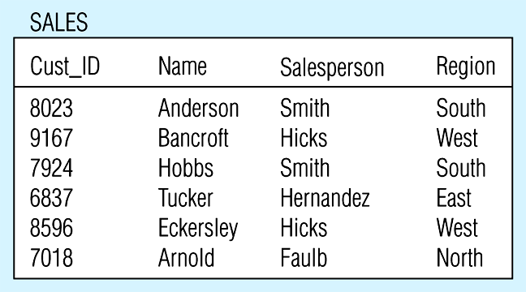
Figure 5-24 -- Relation with transitive dependency
(a) SALES relation with simple data

Slide 32
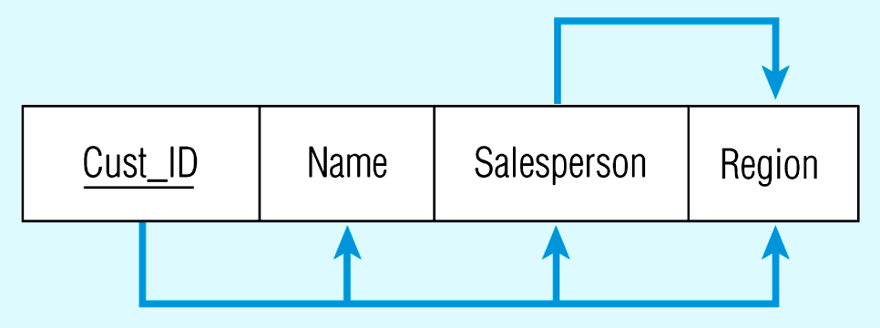
Figure 5-24(b) Relation with transitive dependency
CustID → Name
CustID → Salesperson
CustID → Region
All this is OK
(2nd NF)
BUT
CustID → Salesperson → Region
Transitive dependency
(not 3rd NF)

Slide 33
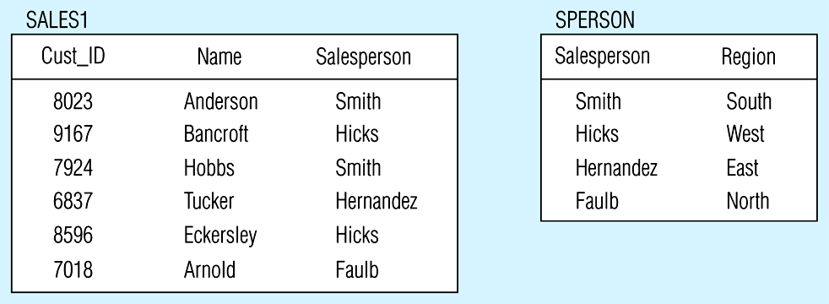
Figure 5.25 -- Removing a transitive dependency
(a) Decomposing the SALES relation

Slide 34
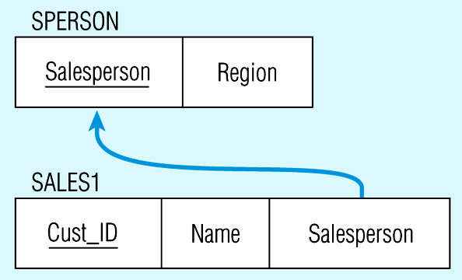
Figure 5.25(b) Relations in 3NF
Salesperson → Region
CustID → Name
CustID → Salesperson
Now, there are no transitive dependencies…
Both relations are in 3rd NF

Slide 35
Third Normal Form
Consider this Employee relation
Candidate keys are? …
EmpNum
EmpName
DeptNum
DeptName
EmpName, DeptNum, and DeptName are non-key attributes.
DeptNum determines DeptName, a non-key attribute, and DeptNum is not a candidate key.
Is the relation in 3NF? … no
Is the relation in 2NF? … yes
Is the relation in BCNF? … no

Slide 36
Third Normal Form
EmpNum
EmpName
DeptNum
DeptName
We correct the situation by decomposing the original relation into two 3NF relations. Note the decomposition is lossless.
EmpNum
EmpName
DeptNum
DeptNum
DeptName
Verify these two relations are in 3NF.

Slide 37
Other Normal Forms
Boyce-Codd NF
All determinants are candidate keys…there is no determinant that is not a unique identifier
4th NF
No multivalued dependencies
5th NF
No “lossless joins”
Domain-key NF
The “ultimate” NF…perfect elimination of all possible anomalies

Slide 38
Boyce-Codd Normal Form (BCNF)
A table is in Boyce-Codd normal form (BCNF) if every determinant in the table is a candidate key.
(A determinant is any attribute whose value determines other values with a row.)
If a table contains only one candidate key, the 3NF and the BCNF are equivalent.
BCNF is a special case of 3NF.

Slide 39
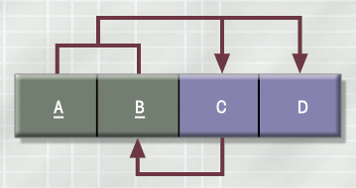
A Table That Is In 3NF But Not In BCNF

Slide 40
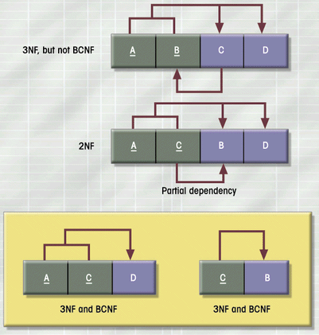
The Decomposition of a Table Structure to Meet BCNF Requirements

Slide 41
In 3NF, but not in BCNF:
Instructor teaches one course only.
student_no
course_no
instr_no
Student takes a course and has one instructor.
{student_no, course_no} → instr_no
instr_no → course_no
since we have instr_no → course-no, but instr_no is not a
Candidate key.

Slide 42
student_no
course_no
instr_no
BCNF
student_no
instr_no
course_no
instr_no
{student_no, instr_no} → student_no
{student_no, instr_no} → instr_no
instr_no → course_no

Slide 43
Sample Data for a BCNF Conversion

Slide 44
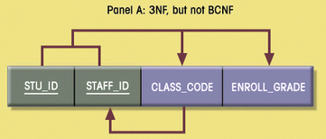
Decomposition into BCNF

Slide 45
Denormalization
Normalization is only one of many database design goals.
Normalized (decomposed) tables require additional processing, reducing system speed.
Normalization purity is often difficult to sustain in the modern database environment. The conflict between design efficiency, information requirements, and processing speed are often resolved through compromises that include denormalization.

